Slide 1



CONTENT GENERATION
AND
SUMMARIZATION TOOL
Under the guidance of : Dr. Hemant Turkar

Slide 2

Introduction
In an increasingly digital world, accessing information is vital across sectors. However, offline environments pose challenges due to limited internet connectivity. To address this, we propose an AI/ML-based Text Summarization Tool for offline access. This tool bridges the gap between online resources and offline needs, enhancing accessibility and productivity. This outlines the necessity, functionalities, implementation approach, evaluation criteria, deployment options, and future enhancements of this transformative tool.

Slide 3


THE PROBLEM STATEMENT
DESCRIPTION
The AI/ML Based Text Summarization Tool using LLM (large language model) for Offline Access will serve as a valuable resource for individuals and organizations operating in environments with limited or no internet connectivity. Here are some key actions and benefits that the model will provide:
Enhance Accessibility
Improve Productivity
Facilitate Knowledge Sharing
Support Decision Making
Enable Offline Learning
Enhance Communication
Customization and Expansion

Slide 4


THE GOAL
THE OBJECTIVE
The objective of creating the Summarization Tool for Offline Access is to provide a comprehensive solution that enables individuals and organizations to access, comprehend, and utilize textual information
Provide users with the ability to generate concise summaries of textual content without requiring internet connectivity,, .
Assist users in making informed decisions by presenting summarized information in a clear and concise manner,
Maintain high standards of quality and accuracy in the generated summaries
Foster knowledge sharing and dissemination by enabling users to easily share summarized information

Slide 5

METHODOLOGY
Research and Planning
Design and Development
Content Creation and Curation
Testing and Quality Assurance

Slide 6
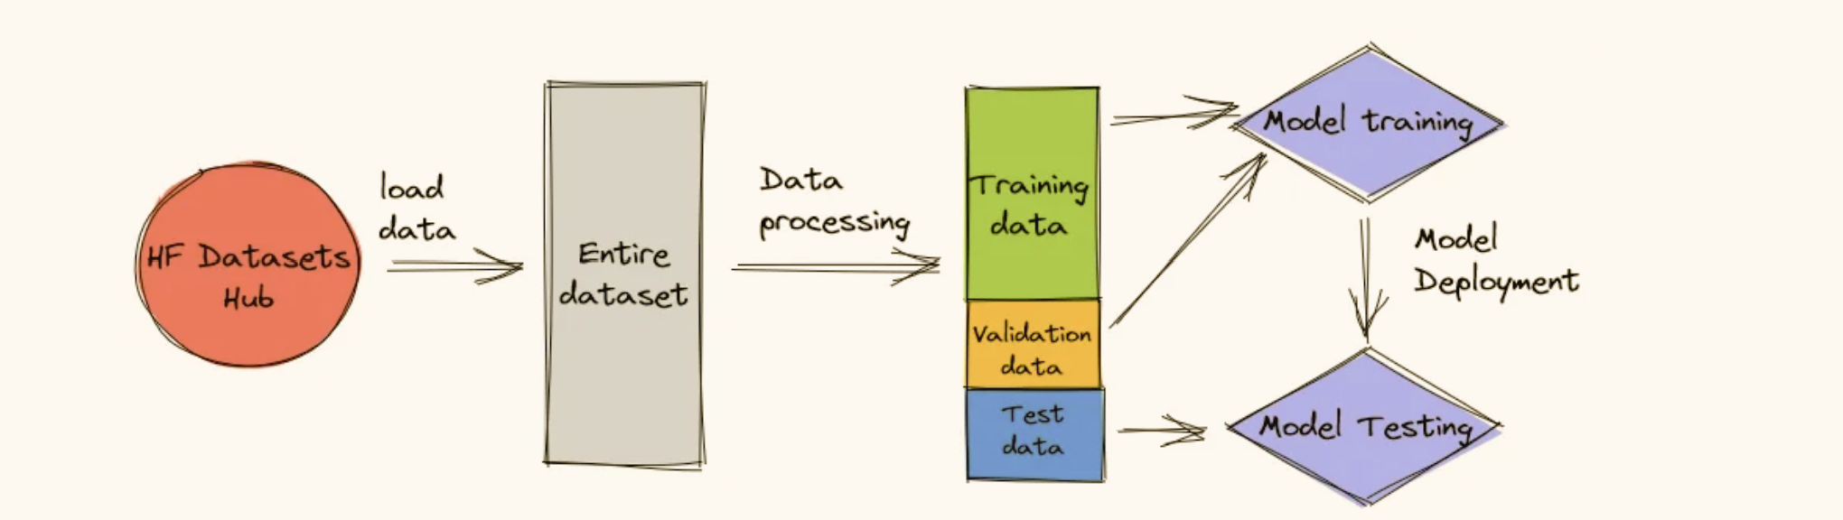
MODEL TRAINING

Slide 7

EXPECTED OUTCOMES
Improved Accessibility: The tool will enable users in offline environments to access and comprehend textual information from a variety of sources, thereby overcoming barriers to information access and fostering knowledge dissemination.
Research Advancement: Researchers and scholars will benefit from the tool's ability to summarize scientific and technical documents, enabling them to quickly review relevant literature and stay up-to-date with advancements in their fields.
Educational Impact: The tool will support offline learning initiatives by providing students and educators with access to educational resources and research materials, fostering a conducive environment for learning and academic growth

Slide 8
CHALLENGES
User Feedback
Data Processing
Algorithm
Model Training

Slide 9

THANK
You

